Slide 1

Robust Car Modification Simulation System using AI
Department of Computer Science
COMSATS University Islamabad, Abbottabad Campus
FATIMA AFTAB FA21-BSE-088
BASIT IQBAL FA21-BSE-050
SYED SHAH HUSSAIN BADSHAH FA21-BSE-172
DR AHMED SAEED KHATTAK

Slide 2
Agenda of the Presentation
Introduction
Scope
Functional Requirements
Non-Functional Requirements
Diagrams
Use cases
Thesis report status
Summary of 100%

Slide 3
Introduction
Web-based tool for modification centers
Realistic previews of vehicle customizations
AI-driven detection for accurate overlays
Enhances customer engagement and confidence

Slide 4
Scope (What to do)
A web-based application for car modification centers that offers high-quality, realistic previews.
Part detection and segmentation for accurate modification overlays on vehicle images.
A wide customization catalog including rims, spoilers, paint, headlights, and side mirror shells.
The ability for operators to upload or capture images of vehicles for customization.
Subscription-based access model for flexibility and scalability.
Focus on external modifications with realistic previews and save options.

Slide 5
Scope (What no to do)
No Real-Time Video Feed Modifications
Exclude Interior Modifications
No High-End Hardware Requirements
Avoid Standalone Installation
No Custom Modifications Outside Catalog
No Complex 3D Modeling

Slide 6
Functional Requirements
FR-001 - Admin Registration
FR-002 - Admin Login
FR-003 - Operator Registration (add operator by admin)
FR-004 - Operator Login
FR-005 - Login Credential Validation
FR-006 - Secure Credential Storage
FR-007 - Upload Image
FR-008 - Capture Image
FR-009 - Image Preview
FR-010 - AI-Driven Part Detection
FR-011 - Overlay Custom Parts
FR-012 - Car Parts Catalog (Inventory)
FR-013 - Manage Catalog
FR-014 - Save Customizations
FR-015 - Retrieve Saved Customizations (View samples)
FR-016 - User Account Management
FR-017 - API Integration for AI Models

Slide 7
Non-Functional Requirements
1. Usability
Easy Image Upload & Preview
User-Friendly Interface
2. Performance
Image Processing Speed
API Response Time
3. Scalability
Support for New Features and Modules
Horizontal Scaling with Minimal Downtime
4. Maintainability
Zero-Downtime Updates and Bug Fixes
Comprehensive Developer Documentation
Modular and Replaceable Components

Slide 8
Continue
5. Accuracy
High Accuracy in Part Detection and Segmentation
Regular Testing and Validation
6. Modularity
Modular Architecture Design
Well-Defined Interfaces for Integration
Easy Addition of New Features
Independent Module Testing
7. Flexibility
Adding New Car Models and Parts
Extensible for Future Modifications
8. Effectiveness
Quick Customization Process
Realistic AI-Powered Previews

Slide 9
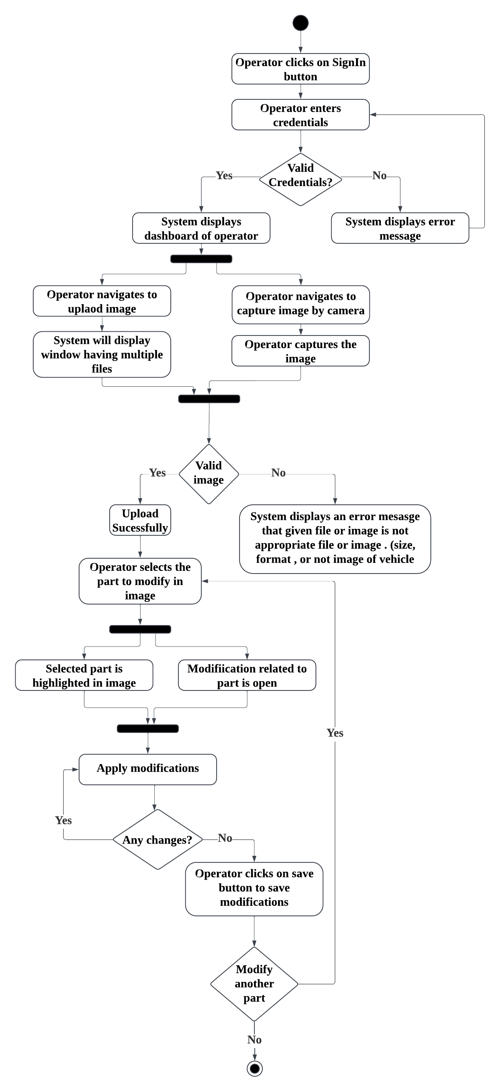
Activity Diagram

Slide 10
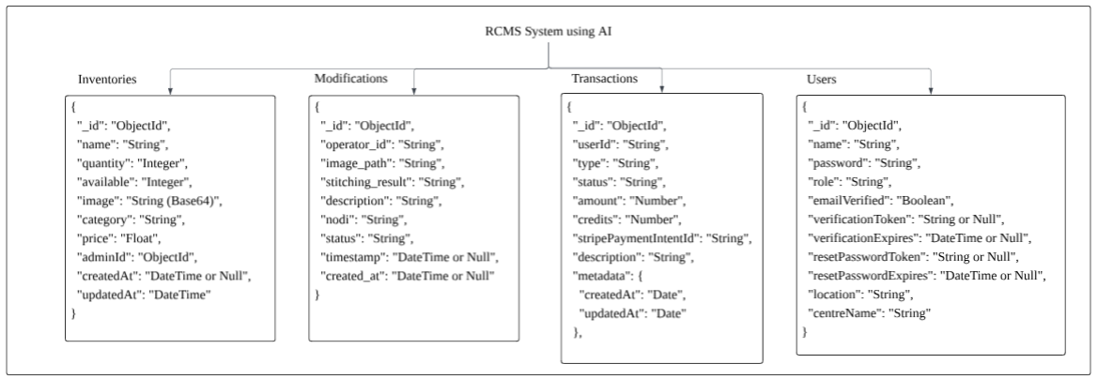
Database Diagram

Slide 11
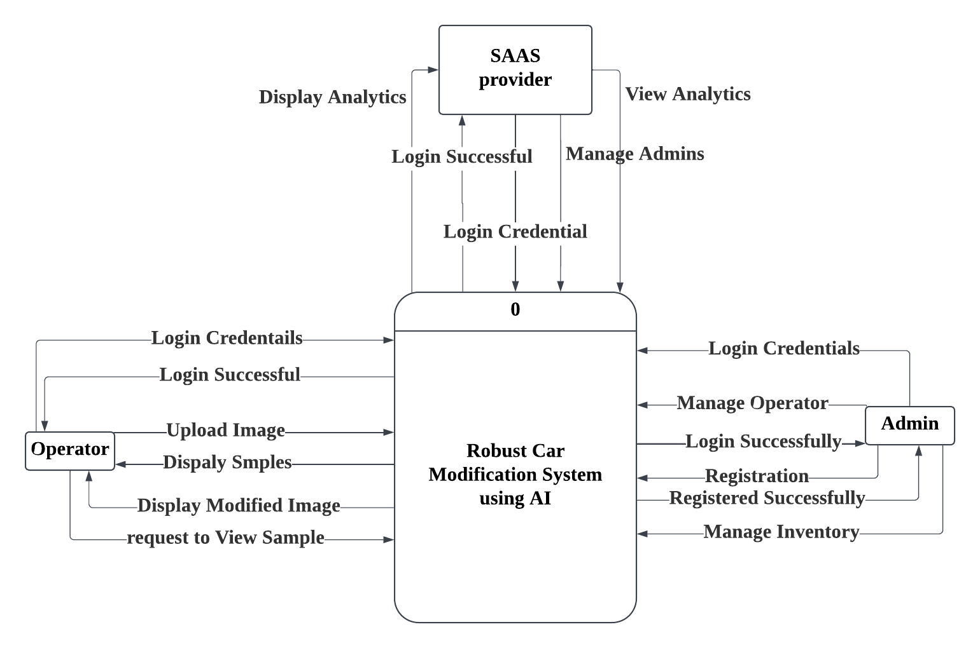
DFD Level 0

Slide 12
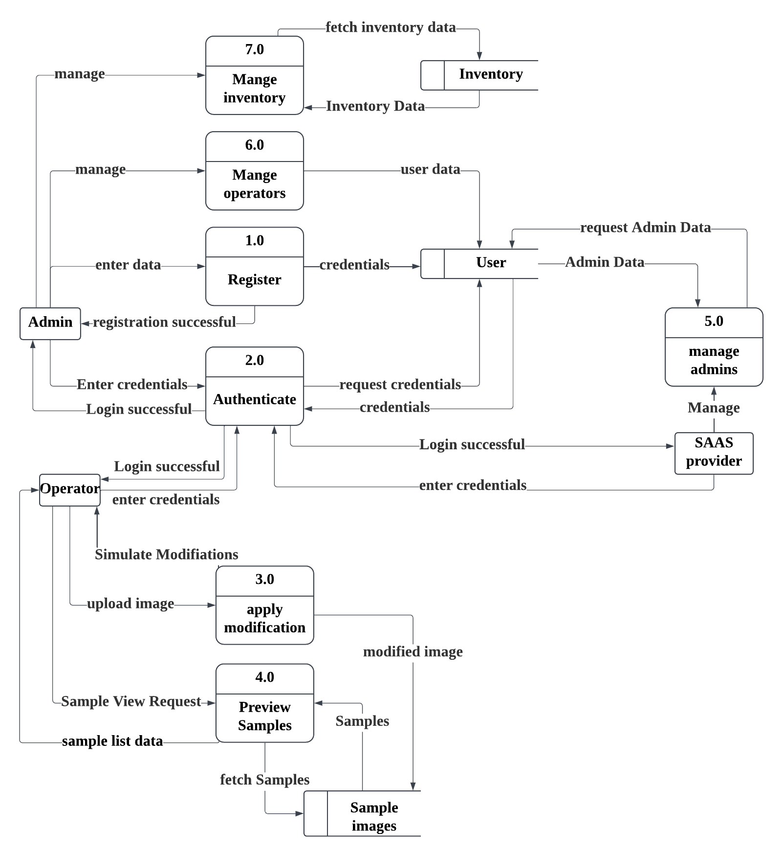
DFD Level 1

Slide 13
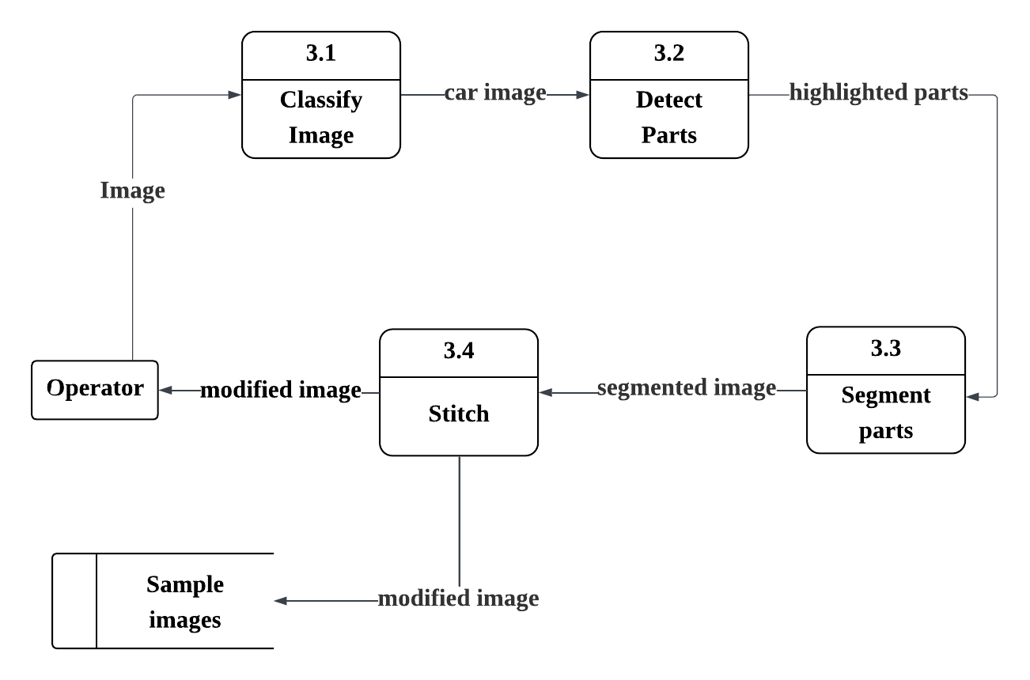
DFD Level 2 (process 3.0)

Slide 14
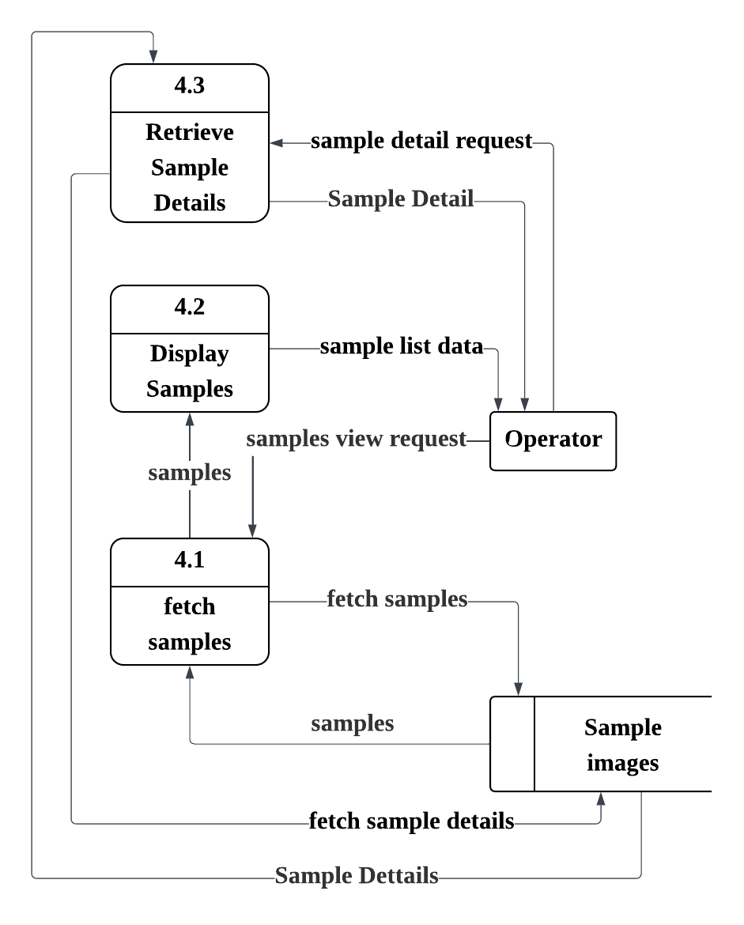
DFD Level 2 (process 4.0)

Slide 15
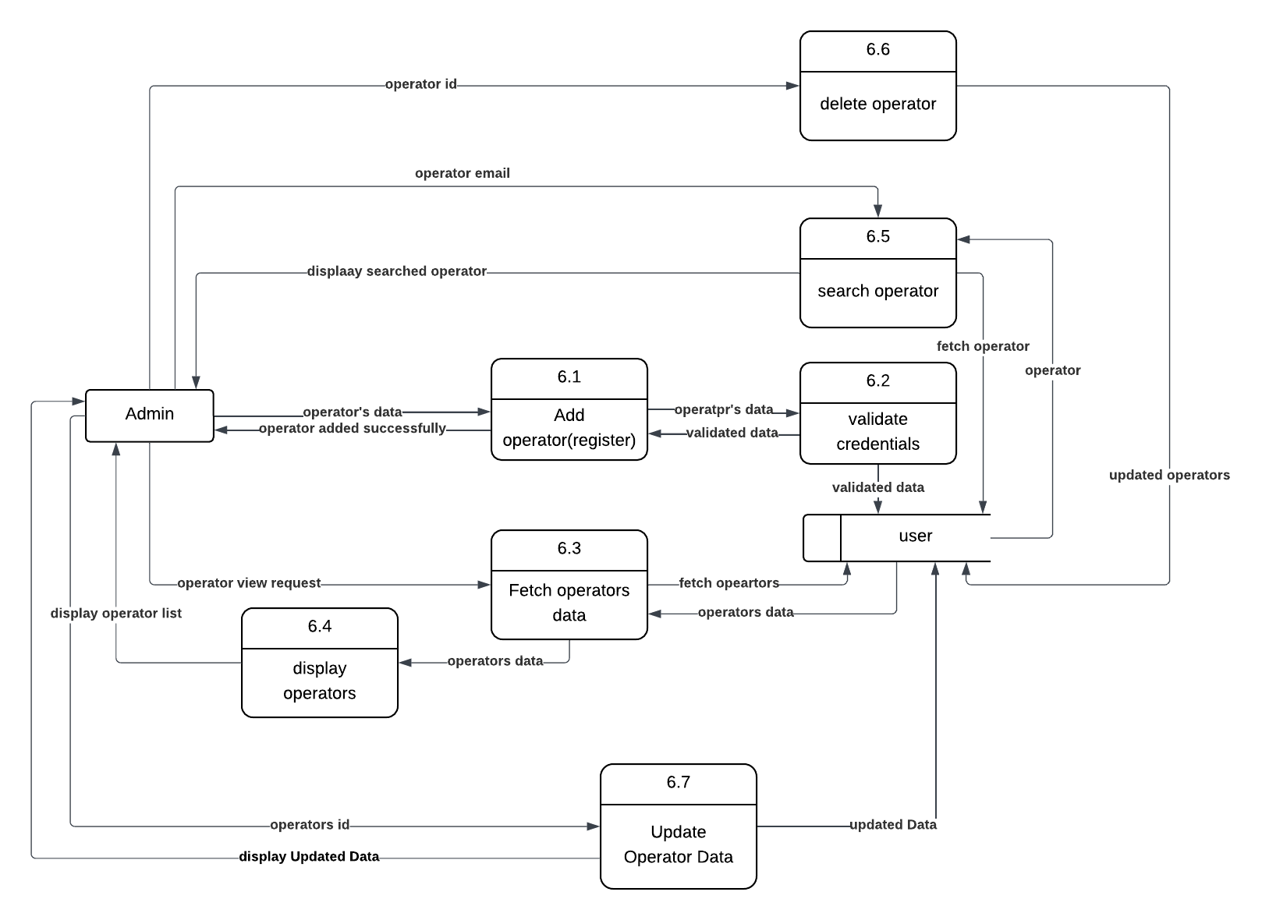
DFD Level 2 (process 6.0)

Slide 16
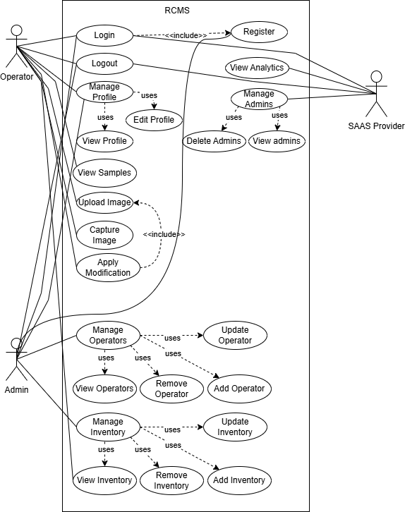
Use Case Diagram

Slide 17
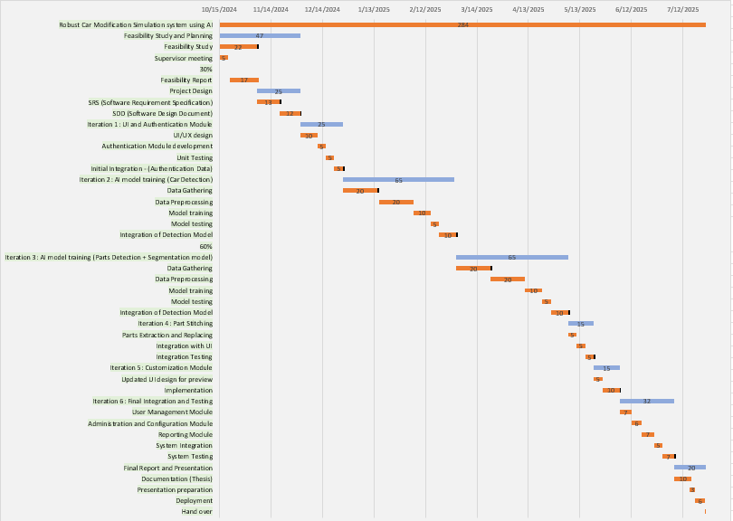
Gantt Chart

Slide 18
Status of Thesis Report
Complete thesis report has been written
All chapters are included (Introduction to Conclusion)
All required diagrams are completed and added
Formatting and structure meet documentation requirements
References and citations are properly included
The document is ready for submission

Slide 19
Summary of 100%
Complete system according to scope
Stitching
Billing
Complete thesis

